Slide 1
Accessories of
Activity-Based Model
Taha Rashidi,
Amarin Siripanich
Maliheh Tabasi
Maryam Bostanara

Slide 2
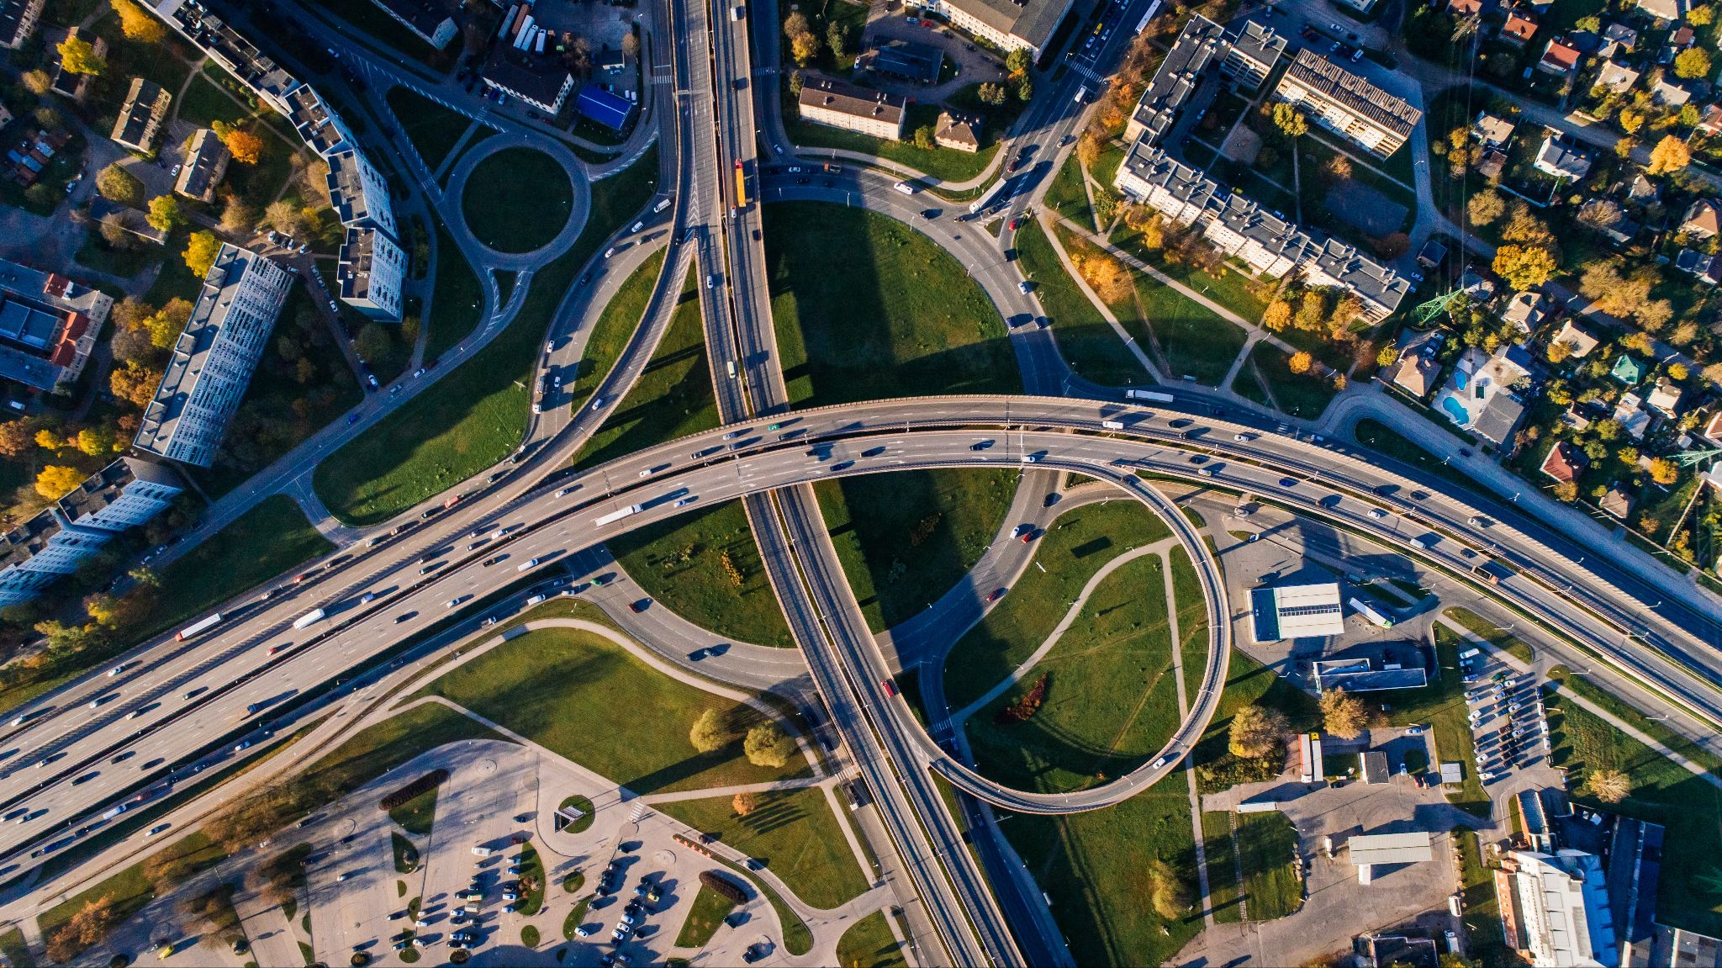
Activity-Based Model
Household travel survey
People and trips
ABM
Network model
Demand
Accessibility
Population_{All years}
Population synthesiser

Slide 3
Activity-Based Model
Travel and time-use app
People, trips,
trajectories, and activities
Population evolution model
ABM
Network model
Population_{t+1}
Demand
Population_{t}
Accessibility
Population_{Base year}
Population synthesiser

Slide 4
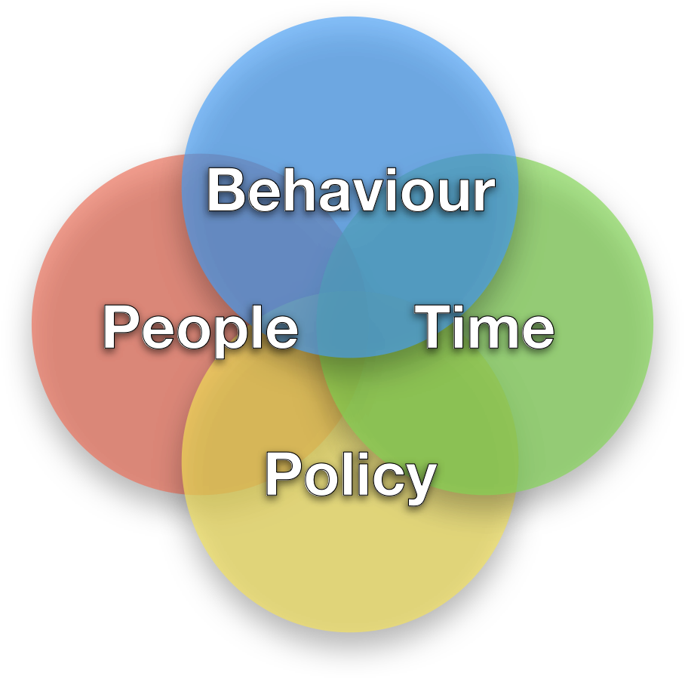
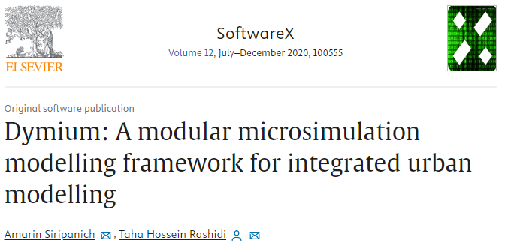
Dymium
Population evolution Model

Slide 5
Dymium offers
… a population evolution model that dynamically micro-simulate changes in a population.

Slide 6
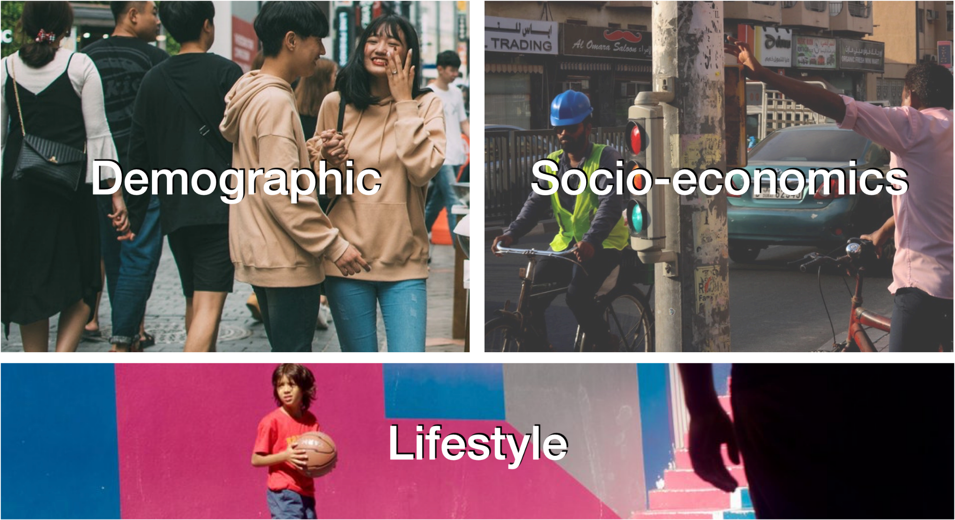

Slide 7
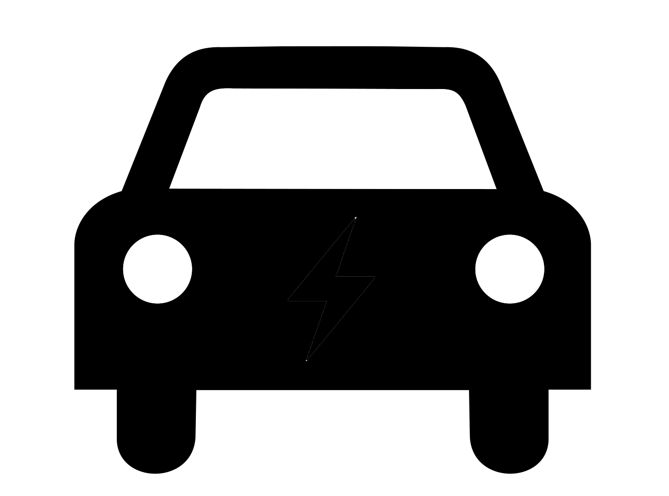
Why evolve when you can synthesise?
Microdata
Population
Evolve
Synthesise
Notes:
The population evolution approach also requires a synthetic population but only for the base year.
Evolve: Evolve the population and their individual-level and household-level characteristics. This will create more diverse households over time.
Synthesise: Always get the same set of households with different amounts depending on the control totals for that year.

Slide 8
The model system
Synthetic population
Records of individuals and households
is comprised of a sequence of events that micro-simulates the population and household dynamics within the synthetic population.
It is designed to be modular to allow for plugging in new events.
Together, they are a population evolution model.
Ageing, birth, and death
Natural changes
Relationship formation
Marriage and cohabitation
Relationship dissolution
Divorce, separation, and breakup
Migration
Immigration and emigration
Leaving parental home
Reasons other than relationship form.

Slide 9
The model system
Synthetic population
Records of individuals and households
is comprised of a sequence of events that micro-simulates the population and household dynamics within the synthetic population.
It is designed to be modular to allow for plugging in new events.
Together, they are a population evolution model.
Population evolution
Population and household dynamics

Slide 10
Use cases
Synthetic population
Records of individuals and households
Simulate ownership and purchase decision of:
private vehicles,
Population evolution
Population and household dynamics
Vehicle ownership
Vehicle transactions of households

Slide 11
Use cases
Synthetic population
Records of individuals and households
Simulate ownership and purchase decision of:
private vehicles, and
residential property.
Simulate decision for:
home relocation,
Population evolution
Population and household dynamics
Vehicle ownership
Vehicle transactions of households
Residential mobility
Home relocation and ownership

Slide 12
Use cases
Synthetic population
Records of individuals and households
Simulate ownership and purchase decision of:
private vehicles, and
residential property.
Simulate decision for:
household relocation,
job change,
work arrangement, and
Population evolution
Population and household dynamics
Vehicle ownership
Vehicle transactions of households
Residential mobility
Home relocation and ownership
Job mobility & work arran.
Job change and relocation decisions

Slide 13
Use cases
Synthetic population
Records of individuals and households
Simulate ownership and purchase decision of:
private vehicles, and
residential properties.
Simulate decision for:
household relocation,
job change,
work arrangement, and
diary travel plan
over time.
Population evolution
Population and household dynamics
Vehicle ownership
Vehicle transactions of households
Residential mobility
Home relocation and ownership
Job mobility & work arran.
Job change and relocation decisions
Travel demand
Simulate individual’s daily travel plan

Slide 14
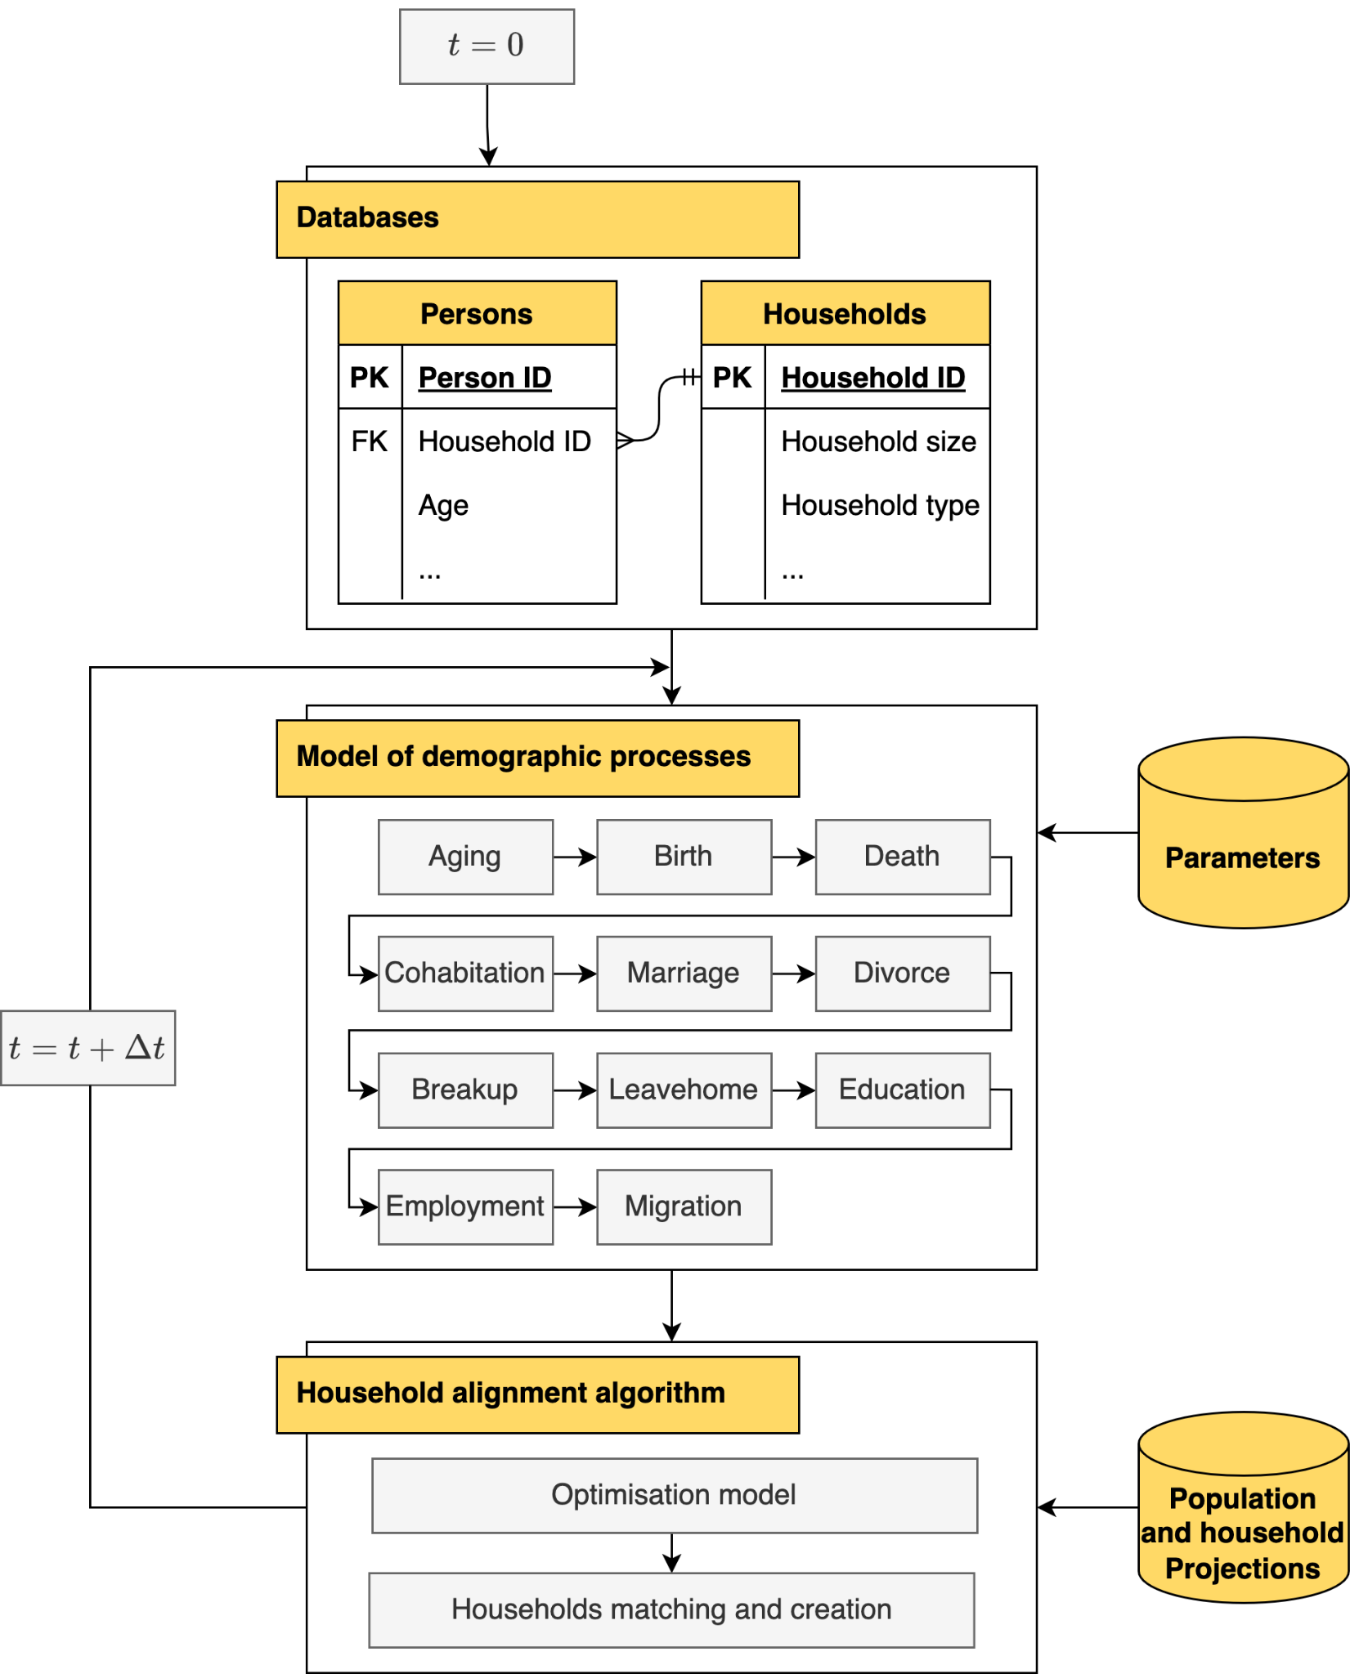
Melbourne model
The proposed demographic microsimulation model consists of 11 events, and these events were simulated sequentially and in discrete time steps, where one time step equals one year.
An alignment algorithm is applied as the last step of the simulation to adjust for any discrepancies between the distribution of simulated and target household compositions.

Slide 15
Alignment (in the context of microsimulation)
… is a process which makes the number of occurrences of an event, happening at the micro-level, adjusted to match its external projection.
Alignment

Slide 16
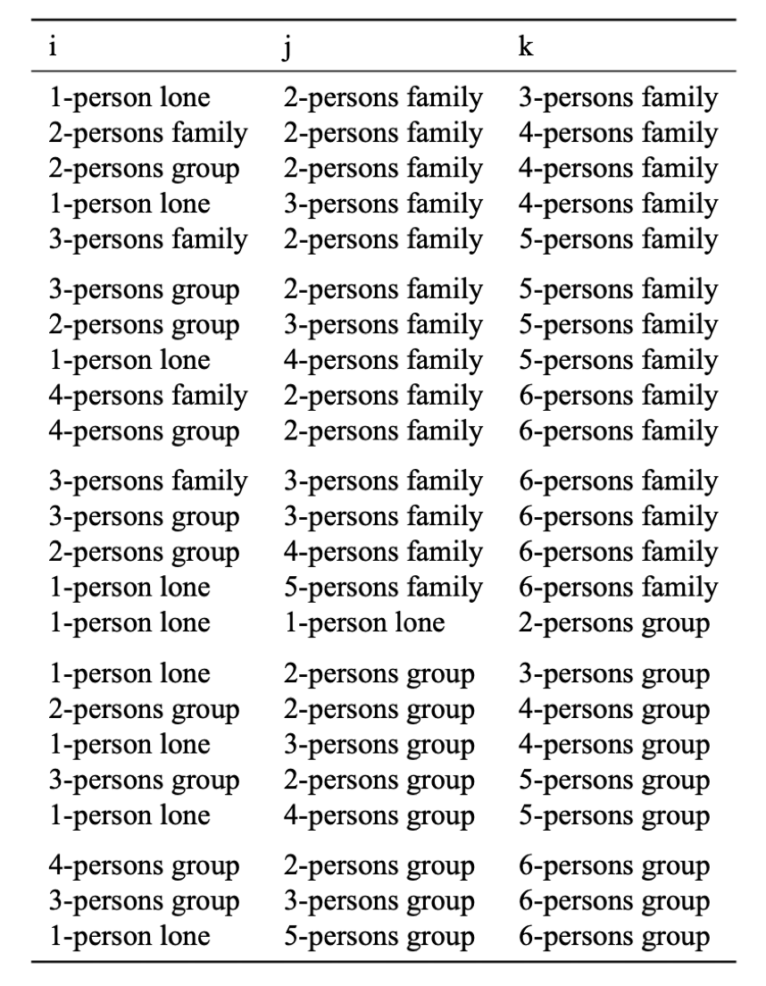
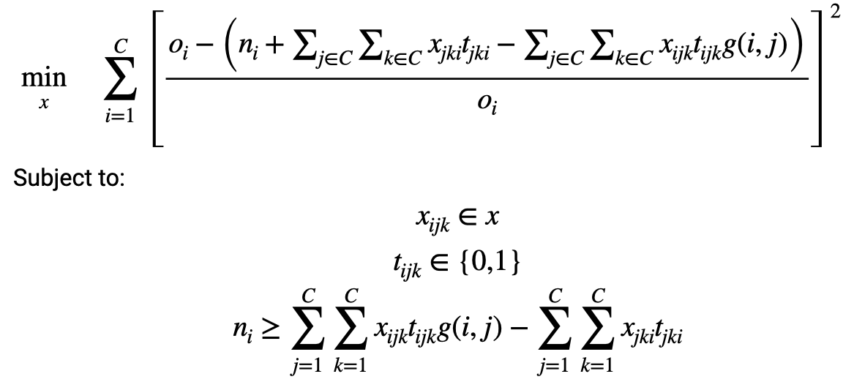
Household alignment algorithm
The goal is to find new household formations (x_ijk) that results in the smallest differences between the target (o_i) and simulated (n_i) number of households. The main assumption being the household formation rules are represented by the matrix t_{ijk}, where the value can either be 0 or 1, indicating whether the formation is possible or not.
Household formation rules expressed as t_{ijk}. i, j, and k are household types, and when t_{ijk} equals to 1 it denotes that households of types i and j can be joined together to form new households of type k, otherwise t_{ijk} is 0. This table only shows t_{ijk}s that equal to 1.
Notes:
x_{ijk}: This is the decision variable representing the number of households of type i and type j that are going to be combined to form new households of type k.
o_i: This is the target number of households of type i, which serves as the benchmark in the optimization problem.
n_i: This is the simulated number of households of type i, which represents the predicted number of households without considering the variables x_{ijk}.
t_{ijk}: This is a value inside a 3-dimensional matrix representing the household formation rules, where each value inside the matrix can either be 0 or 1. The matrix determines the rules for combining households of type i and type j to form households of type k.
C: This is a set that denotes the household types considered in the model: family households with 2 to 6 people (5 types), group households with 2 to 6 people (5 types), and lone person household (1 type).
g(i, j): This function serves as a logic gate to account for the formation of a household of the same type. It returns 2 when households i and j have the same type and 1 otherwise.
Constraints: The constraints ensure that the sum of the variables x_{ijk}g(i, j) is less than or equal to n_i for all i, ensuring that the predicted number of households does not exceed the target number.

Slide 17
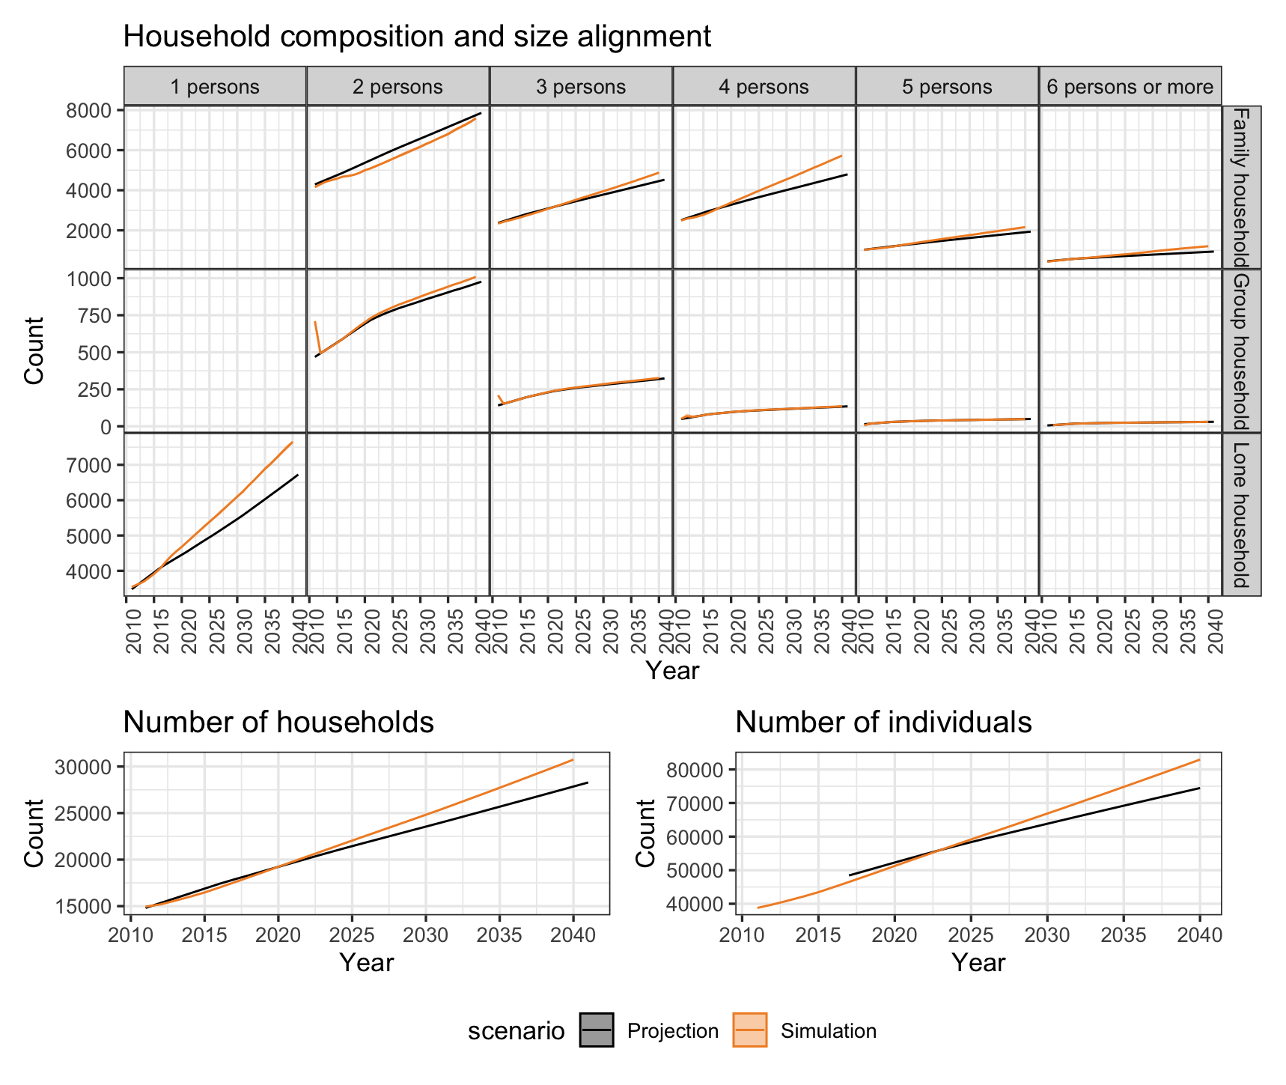
Melbourne model
is a population evolution model that iteratively updates a 2011 synthetic population to the year 2040.
The main challenge was to make the marginal distributions of household composition and size closely aligned with the official household projection provided by ABS.

Slide 18
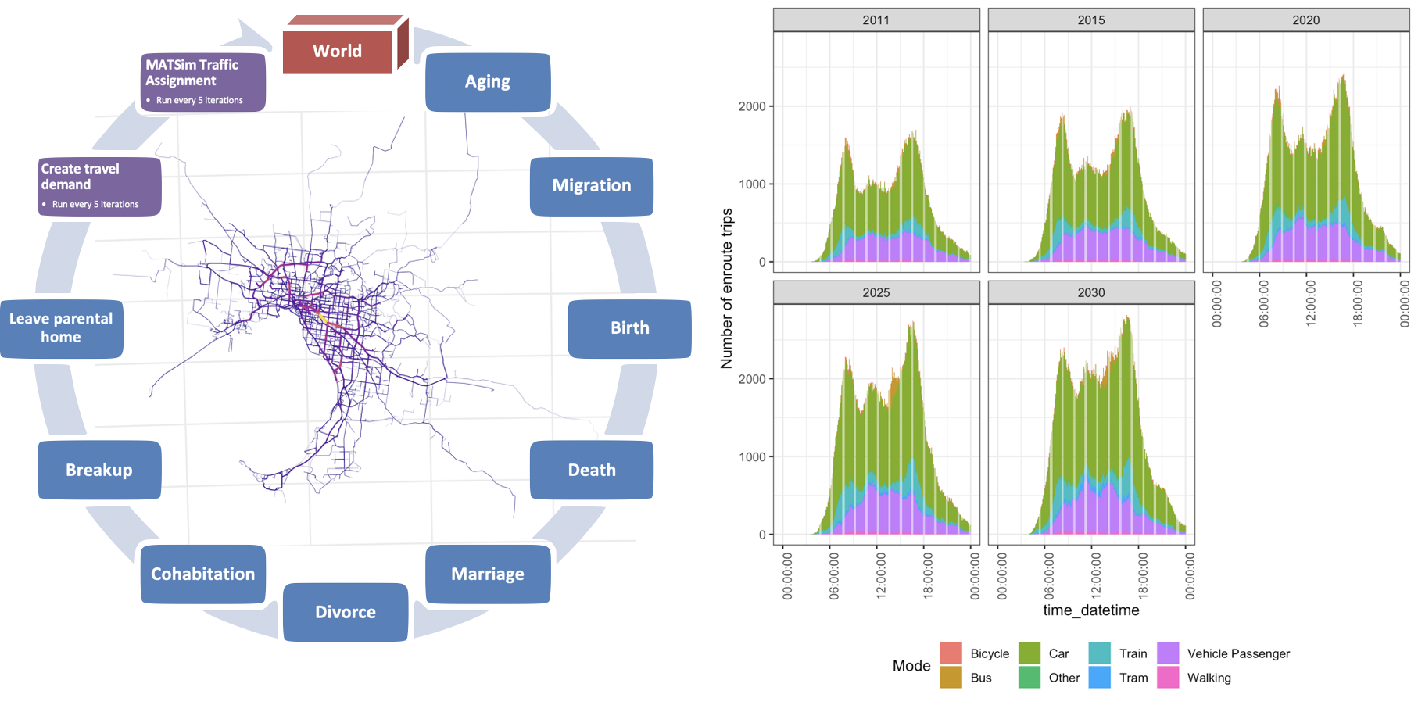
Siripanich, A., & Rashidi, T. H. (2020). Dymium: A modular microsimulation modelling framework for integrated urban modelling. SoftwareX, 12, 100555.

Slide 19
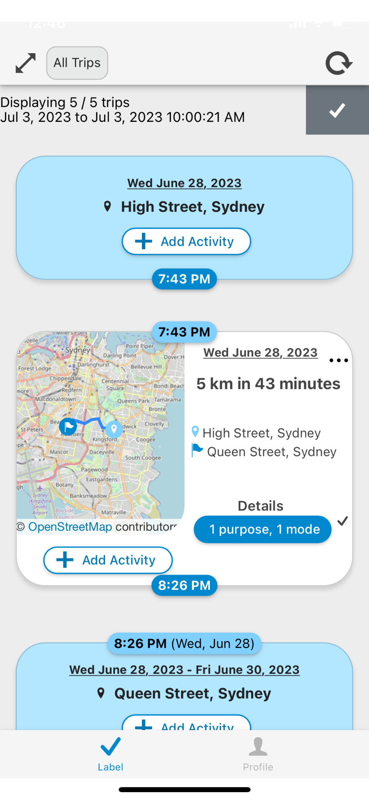
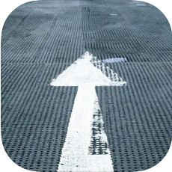
Fourstep
Travel and time-use diary App
In collaboration with K Shankari’s team from NREL and Alireza Raei at UNSW

Slide 20
Introduction
Household travel surveys (HTS) diary data provides essential details on trip attributes such as distance, time, mode, purpose, and cost, facilitating the development of travel demand models.
Another data source, less used compared to HTS that can contribute to a better understanding of urban travel behaviour is time-use data.
Thanks to technological advancements and the widespread ownership of smartphones, researchers can now collect more reliable travel diary data using GPS-aware smartphone applications explicitly designed for this purpose
Lately, time-use data can also be gathered using smartphone apps.
GPS-aware smartphone applications can facilitate collecting travel and time-use data.

Slide 21
Introduction
Advantages of collecting travel and time-use data together
Travel behavior insights:
Deeper analysis of - the reasons behind travel and preferred modes of transport, - multitasking behaviour while travelling, - value of travel time saving - the impact of travel on overall time allocation.
Holistic Urban Planning:
making informed decisions by considering:
travel patterns AND broader context of daily activities,

Slide 22
Introduction
A crucial aspect of travel and time-use data collection using smartphone applications that may not receive the attention it deserves is the recruitment process of participants willing to install such apps on their personal smartphones and input their travel and activities into these apps.
Our research aims to …
Discuss the recruitment of participants for such survey through:
Consumer panels of market research companies
and Social media advertising platforms
Explain the data collection process
For Sydney and Chicago
Analyse the impact of different levels of incentives
Provide ravel and time-use behaviour analysis (and multitasking)
Image by Freepik

Slide 23
Fourstep offers
… a cost effective, rapidly deployable solution for travel behaviour data collection – that is also easily scalable with your project’s budget.

Slide 24
So far we’ve collected
Australian capital cities
Travel diaries of 100 essential workers during the start of COVID-19.
Chicago, US
Travel and time-use diaries of 500 Chicago residents
2020
2022
2021 & 2023
Sydney, Australia
2021 - Travel diaries of 130 Sydney residents during the second COVID-19 lockdown.
2023 - 100 Sydney cyclist travel diaries collected for an ARC project.

Slide 25
How Fourstep works

Slide 26
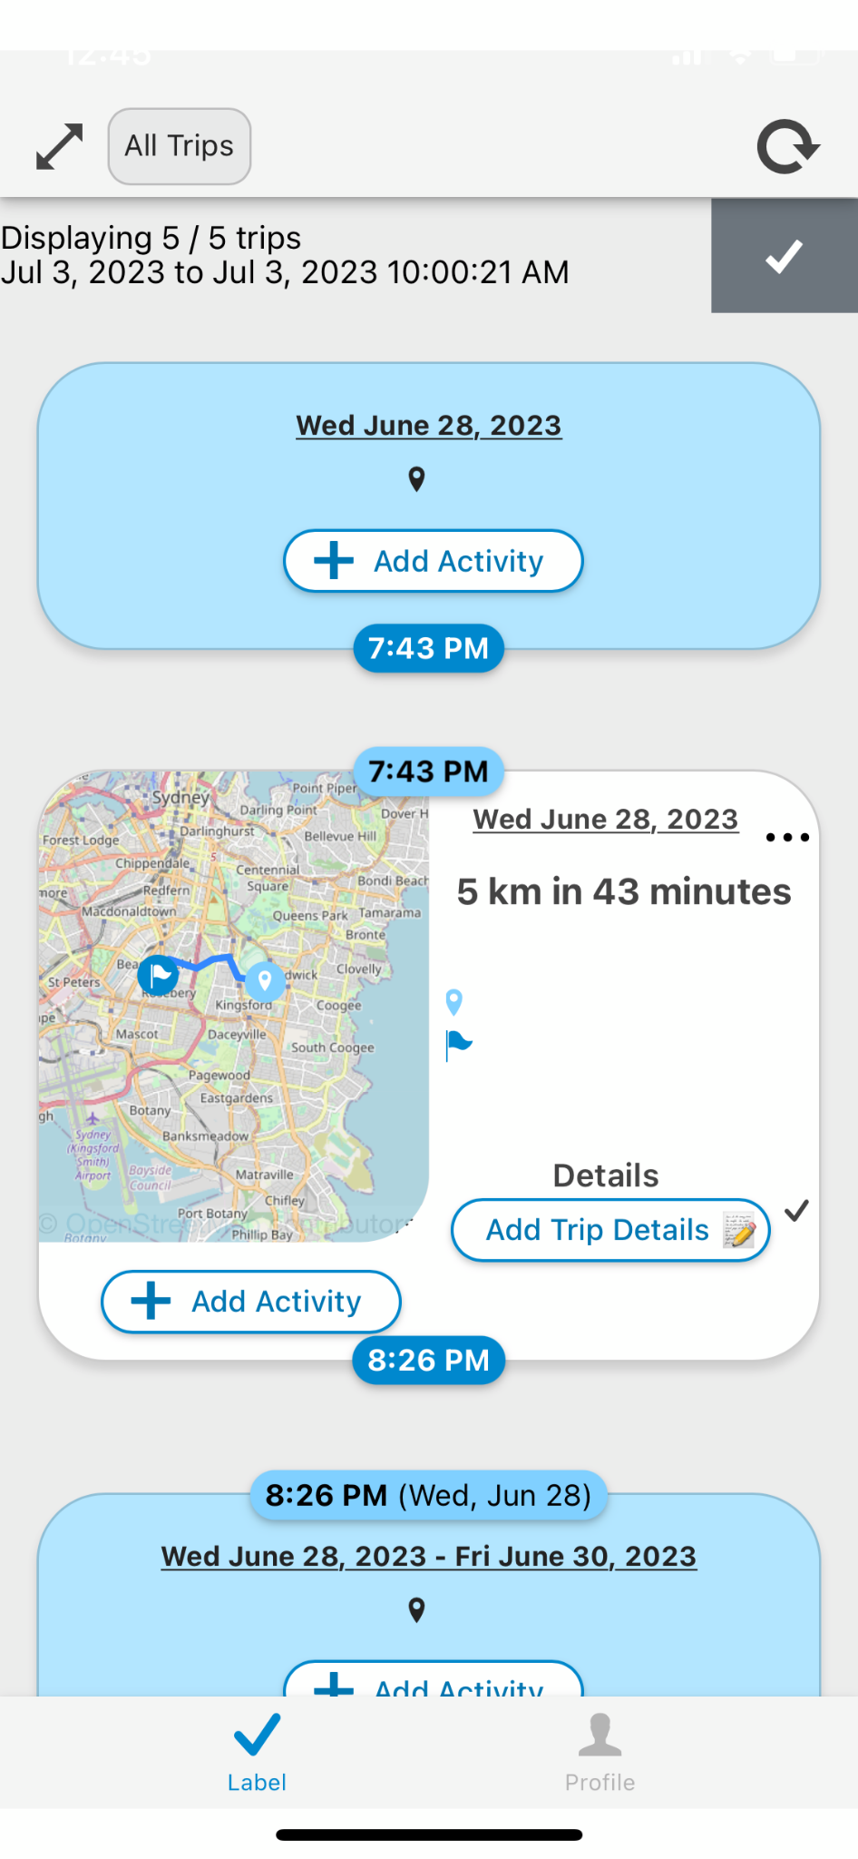
“Label” tab displays trips and stays
A stay
A trip

Slide 27
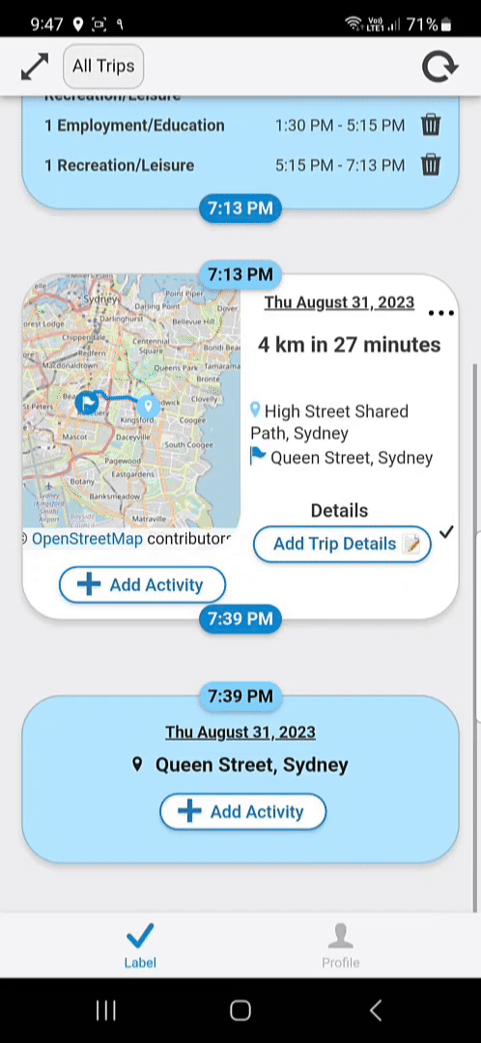
User can add trip details …

Slide 28
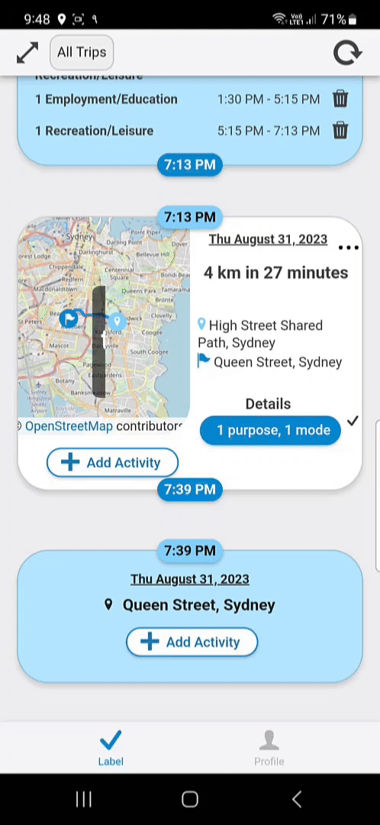
.. and the activities they have done during that trip.

Slide 29
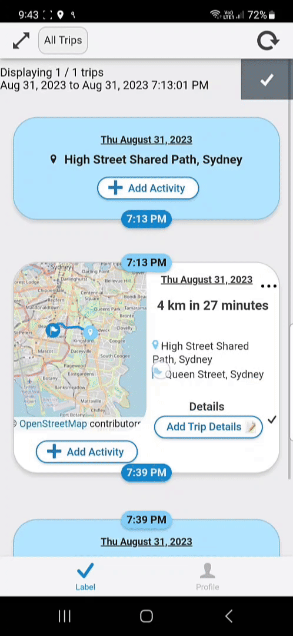
User can also add their daily activities at stays.

Slide 30
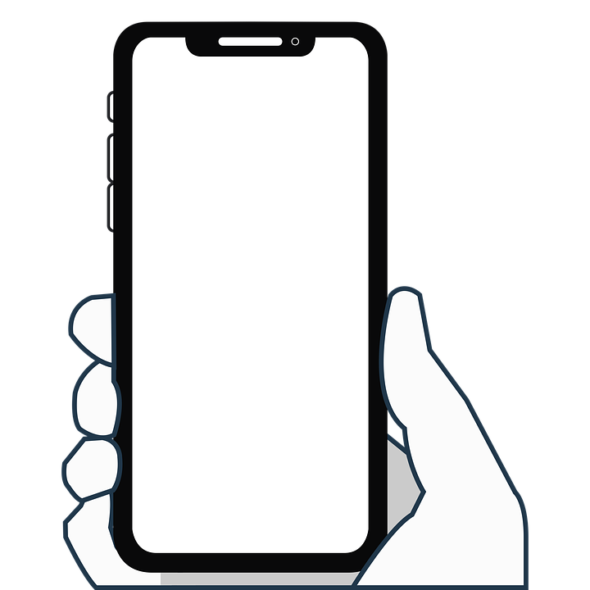
Databases
User profile
User’s socioeconomic and demographic characteristics
User manual inputs
Response to in-app surveys
Trip diary
Trip’s characteristics and trajectory
Time-use diary
Time-use activities and their durations
Sensors
GPS, accelerometer, gyroscope, etc.
Device info
Device, battery, and other raw sensor data

Slide 31
Deployer’s perspective
Core server
Handle API requests (sending and retrieving data)
Analysis pipeline
Process raw sensed data (trip segmentation, mode infer.)
Deployer’s dashboard
Real-time monitoring
Public dashboard
Aggregated and non-sensitive daily report of the study

Slide 32
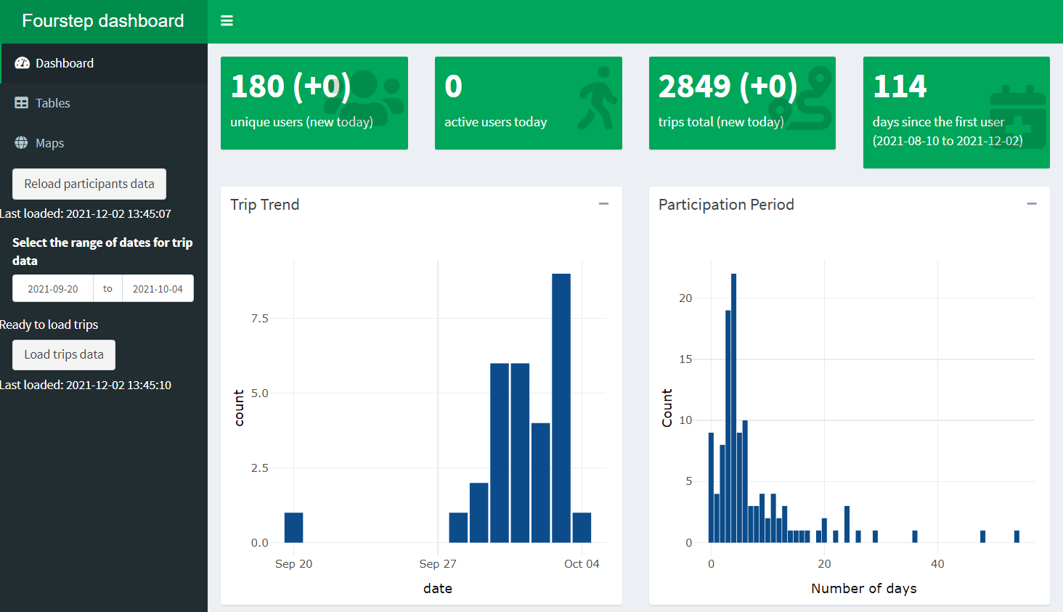
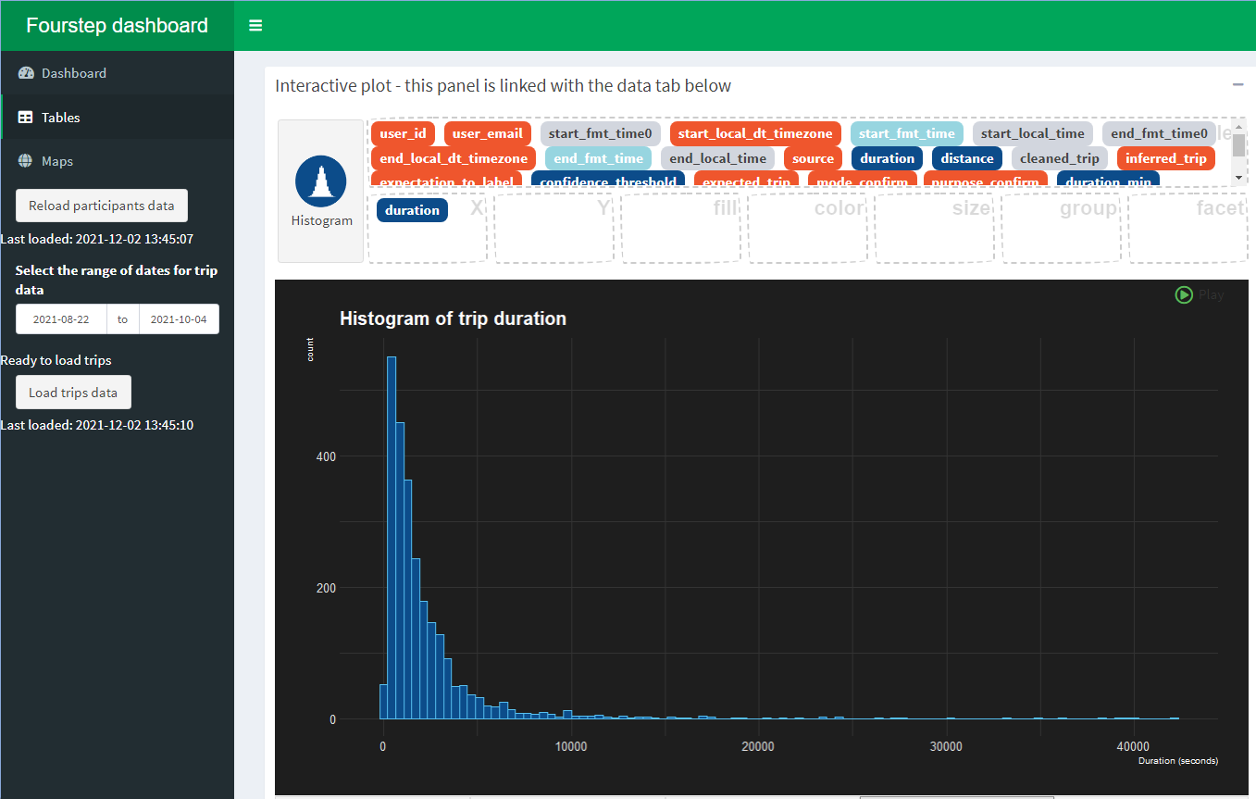
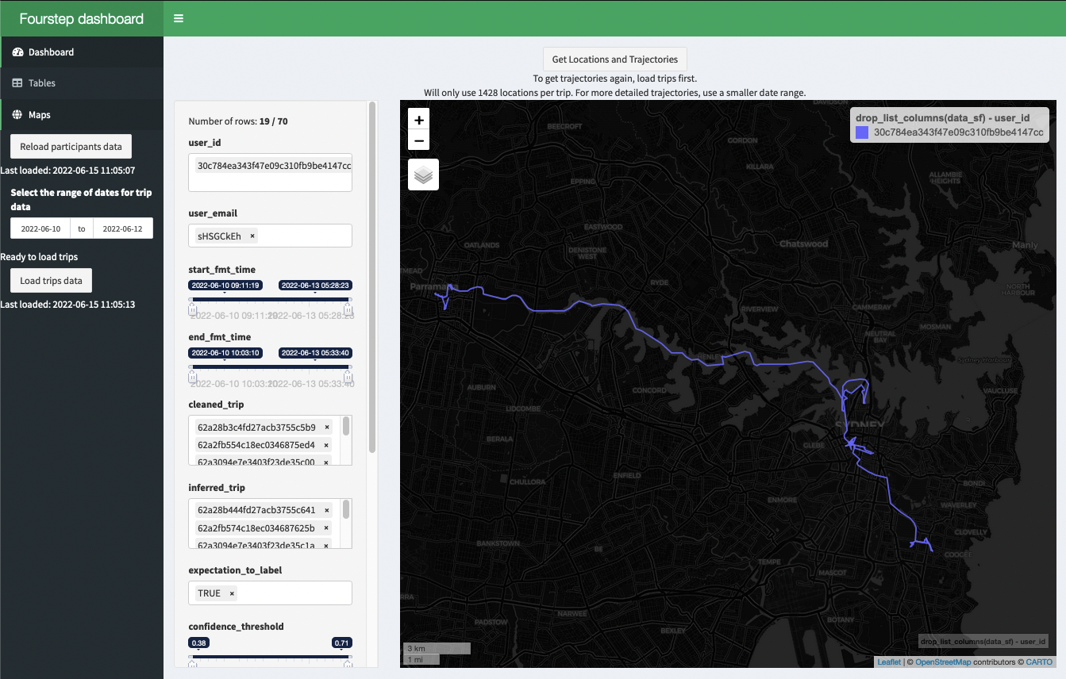
Deployer’s dashboard
Allows the deployer/administrator to monitor the study in real-time.
Features:
Daily report
Data export
Interactive visualisation
Diagnostic data
ML problem detection
Notes:
ML problem detection: detect issues on the user’s device using diagnostic data and ML model.

Slide 33
Plans
 | Basic | Deep data
Recruitment
Targeted recruitment |  | ✅
Data collection
Trip diary | ✅ | ✅
Time-use diary |  | ✅
Social dashboard |  | ✅
ML mode detection | ✅ | ✅
Deployment, analytics, and support
Daily report automation | ✅ | ✅
On-cloud | ✅ | ✅
On-premise |  | ✅
Real-time dashboard |  | ✅
Phone assistance for users |  | ✅
The Basic plan is suitable for studies that focus on collecting people’s travel diaries.
Our Deep data plan provides additional features for capturing extra dimensions of people’s trip-making characteristics and greater support in deployment and user assistance.

Slide 34
There are Four steps in Fourstep
⚙️ Deployment
Setup infrastructure
04
📦 Delivery
Feed into a model pipeline
01
03
📣 Recruitment
Manage Ads
Targeted recruitment
💁‍♂️ Data collection
Manage UX
Assist participants
Distribute rewards
02

Slide 35
Recruitment: cost, speed, and scale
Baseline
Cost
* A recent quote from the same company is close to 9.0x of Fourstep’s.
1.00x
2.80*
Compared
to Fourstep
Fourstep
Market research company
Participants are social media users from a diverse and large sampling frame.
Participants are professional survey takers.
Large frame, low response rate.
Cost-effective.
Faster to deploy.
Much more scalable with budget.
Small frame, high response rate.
More expensive.
Risk of poor data quality.
Limited.
(Under-reviewed) Siripanich, A., Rashidi, T. H., Shankari, K., Saberi, M., Waller, T., Dixit, V., & Nair, D. (2022). Broad Reach and Targeted Recruitment Using Facebook for smartphone travel surveys. Transportation Research Part A: Policy and Practice.
Notes:
Qualtrics: 326 completions cost $20000 in 2018, ($21,081.20 in 2021’s dollar value), $64.66 per completion
Fourstep: 90 completions cost $2080 in 2021, $23.11 per completion

Slide 36
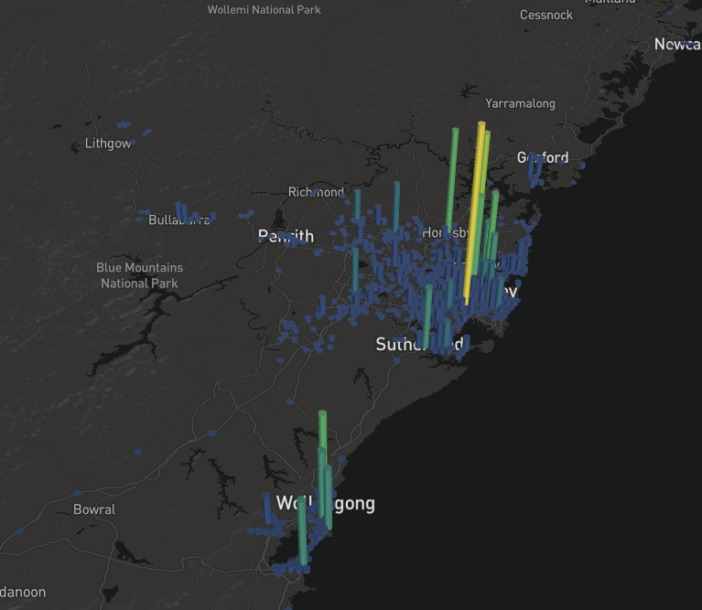
2023 Sydney cyclist travel survey
Since mid-December 2022, we have been conducting a 7-day Sydney cyclist smartphone travel survey.
All invited participants stated that they cycled at least two days per week.
Their cycling behaviour and attitudes were also collected during the on-boarding stage.
Frequency of visited areas of all participants

Slide 37
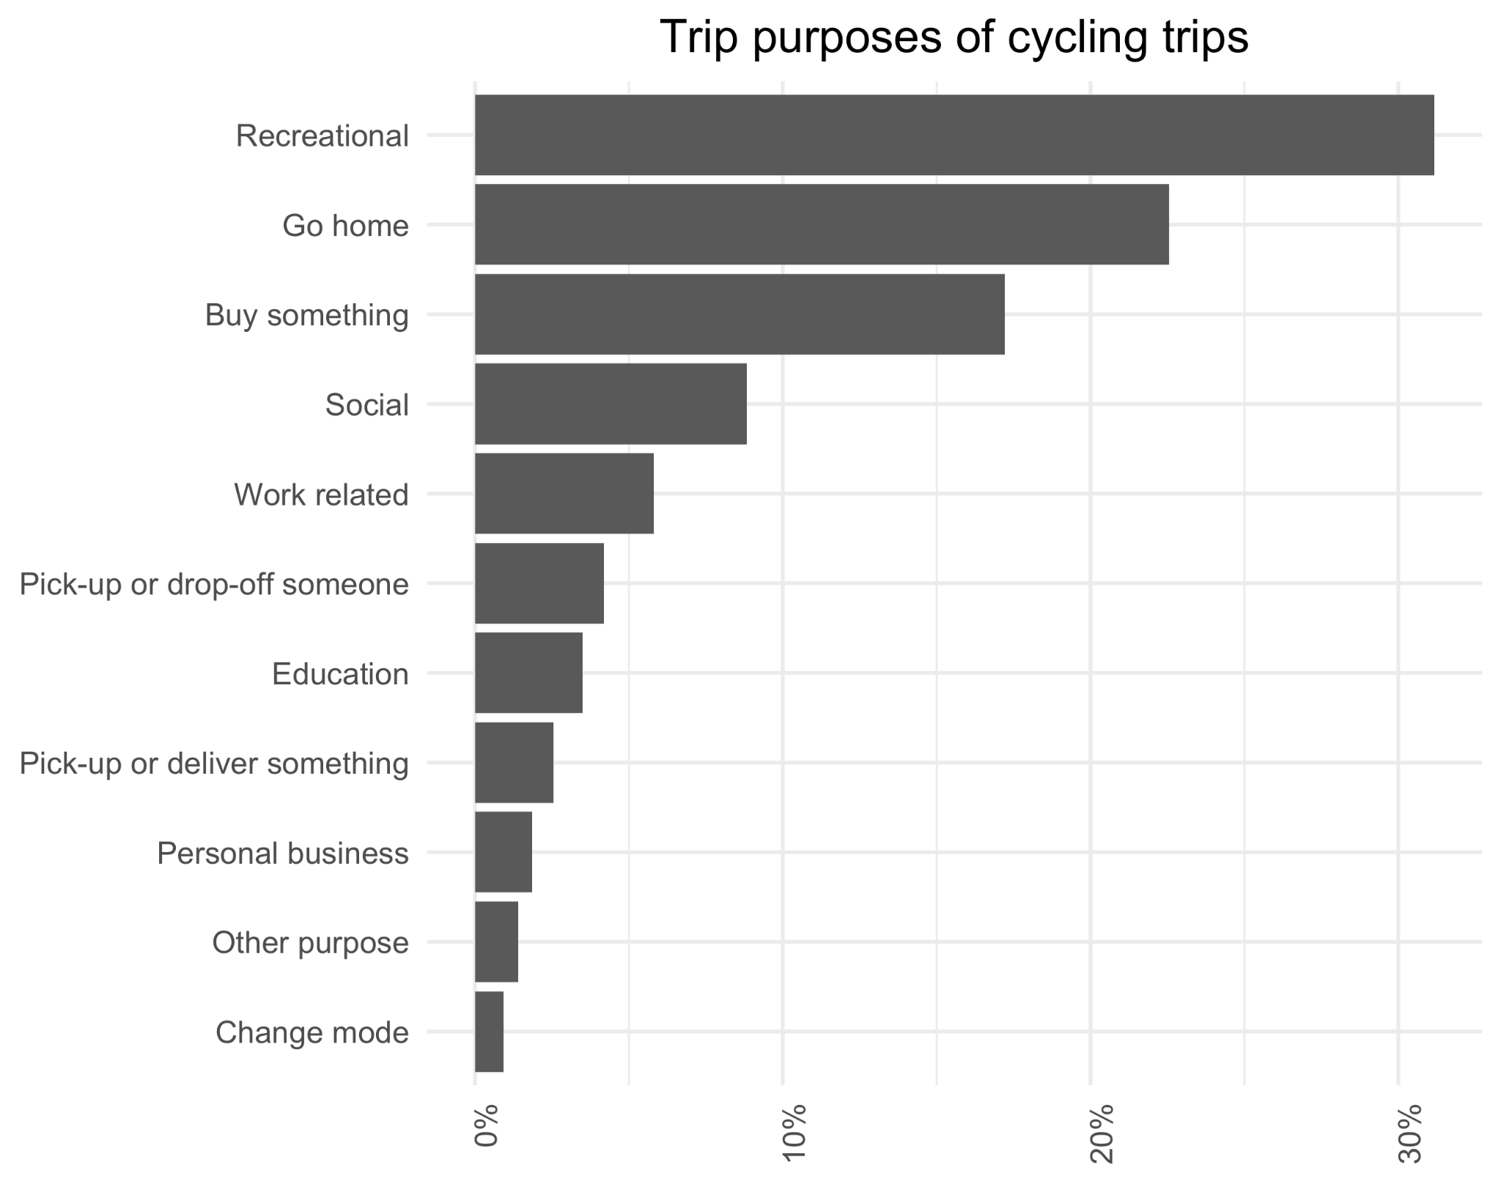
2023 Sydney cyclist travel survey
As of February 6th 2023,
85 participants have used the app to record 5,769 trips,
with 7.6% (443 trips) being cycling trips.
Additionally, 20% of all cycling trips recorded were done on e-bikes.
87.8% of all trips have trip details (mode and purpose).

Slide 38
Data collection method
Three main components:
Participant recruitment
01
Onboarding survey
02
GPS-aware smartphone application
03
Icon by Flaticon

Slide 39
1- Participant recruitment
Older than18 who reside in Chicago or Sydney.
We outsourced the marketing task to an international market research company
to recruit survey participants.
They did not successfully recruit participants in Chicago.
Maybe because they depend on local area providers.
We directly engaged in the marketing activity .
We ran campaigns through social media advertisement platforms to recruit Chicago residents.
Icon by Flaticon

Slide 40
1- Participant recruitment
Our final campaigns in Facebook ads, which are displayed to our target audiences on Facebook and Instagram.
Can target specific demographics and geographical regions.
Mentioning survey incentives in ad materials led to fraudulent activity.
it's more effective to introduce the incentive on the first page of the landing page while removing it from the advertisement material.
Icons by Flaticon

Slide 41
2- On-boarding survey
It is the landing page for our social media campaigns
Divided into 4 sections
Introduces the study to participants, including eligibility criteria and the participation incentive.
1- Terms and conditions
Gathers information about participants' smartphone operating systems and whether they are accessing the survey
on a computer or smartphone to streamlines the onboarding process.
2- Overview
Participants provide demographic information and their email addresses for receiving participation incentives.
3- Profile survey
Participants are asked to install the app on their phones. They are provided with login tokens and instructions on how to install, set up and log in to the app.
4- Fourstep app

Slide 42
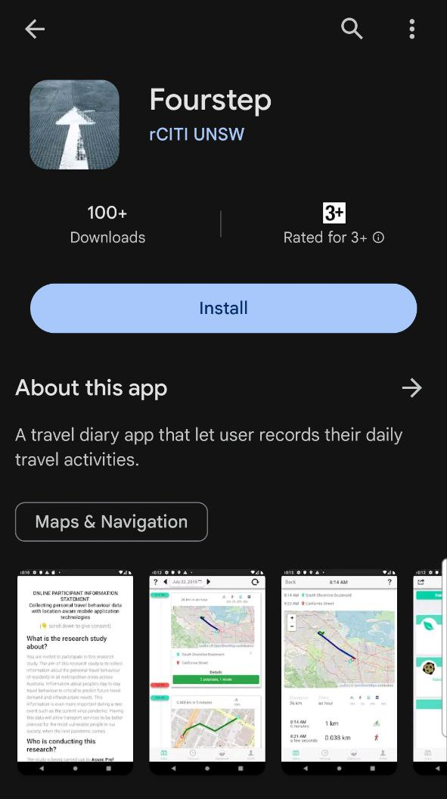
3- GPS-aware smartphone application
Fourstep smartphone app
Collects data on travel behaviour and time use
Fourstep is based on the open-source OpenPath app (Kosmacher and Shankari, 2023)
Enables integrated travel and time-use data collection while capturing multitasking and activity timing.
Available for both iOS and Android

Slide 43
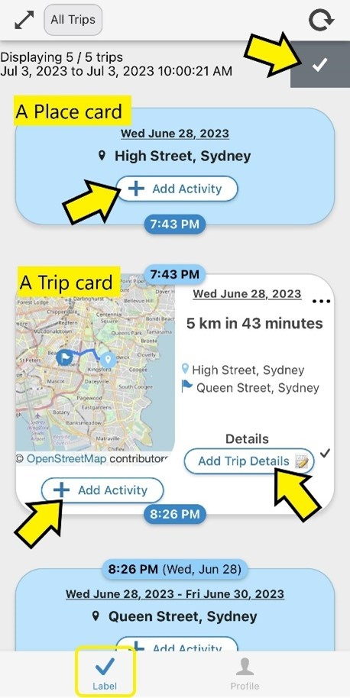
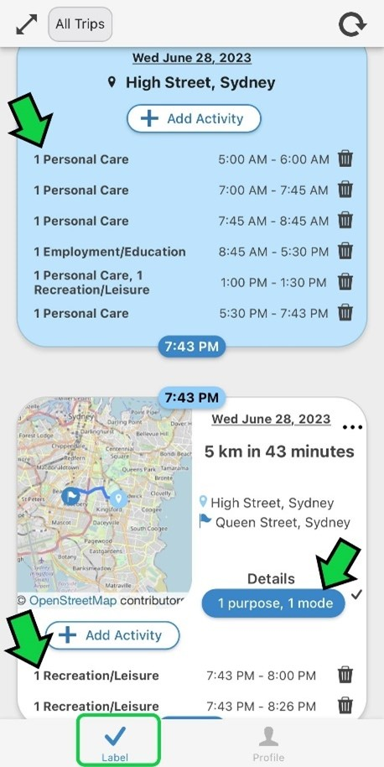
3- GPS-aware smartphone application
User adds trip details and activities

Slide 44
Participant recruitment analysis
City-campaign | Incentive (USD/day) | FB** Ads. budget (USD/day) | Campaign Duration (days) | Profile survey records | Number of tokens assigned | Number of app installations | %App installation/profile survey records
Sydney- MRC* | Administrated by a market research company |  | 12 | 301 | 130 | 53 | 17.6
Chicago- MRC |  |  |  | 315 | 1 | 1 | 0.3
Chicago- FB | Break down as below | Break down as below | 85 | 250 | 182 | 77 | 30.6
Chicago- FB1 | 5 | 10 | 64 | 36 | 23 | 9 | 25.0
Chicago- FB2 | 10 | 100 | 12 | 116 | 93 | 42 | 36.2
Chicago- FB3 | 7 | 100 | 9 | 98 | 66 | 26 | 26.5
* Market research company **Facebook

Slide 45
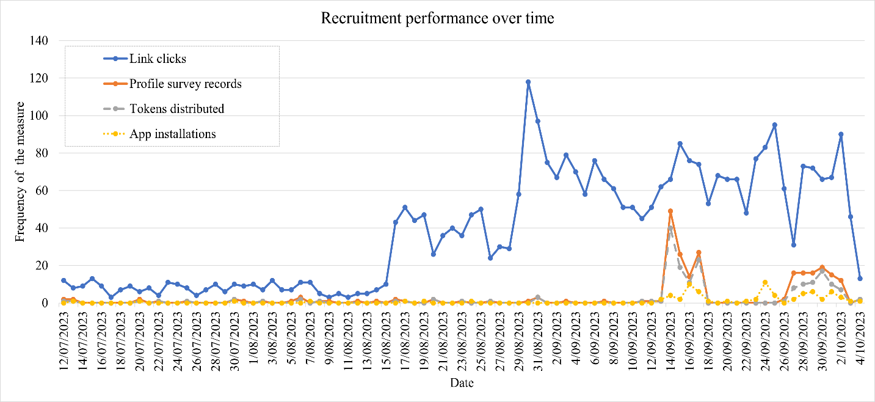
Participant recruitment analysis
Participation incentive is set to 10 USD/day
Participation incentive is set to 7 USD/day
FB advertisement budget is increased to 100 USD/day

Slide 46
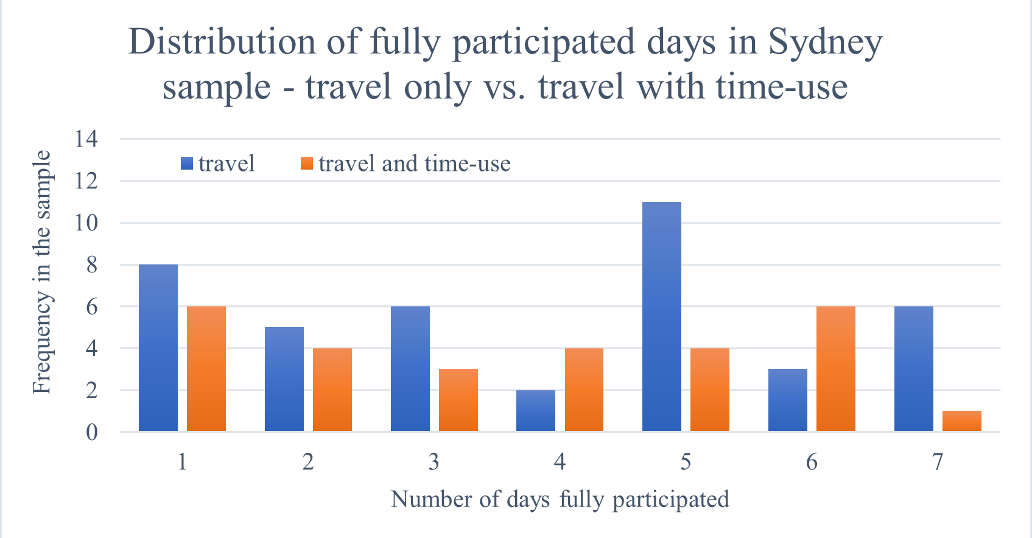
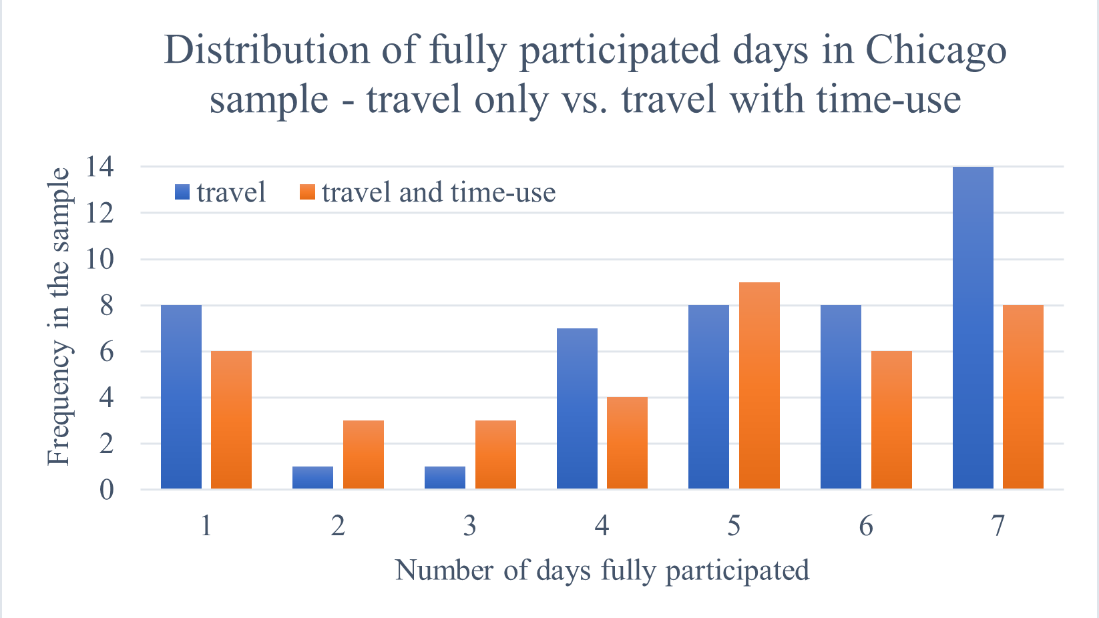
Participation distribution
Participants recruited through social media are more likely to complete the full-week travel and time-use survey relative to those recruited by market research companies.

Slide 47
Descriptive data analysis
May not be representative of the time-use behaviour of the population of these two cities as our sample size is relatively small.
1- Travel Behaviour Analysis
2-Time-use Behaviour Analysis
 | Chicago | Sydney
Total number of recorded trips | 2437 | 1289
Total number of trips with user input info | 1402 | 737
 | Chicago | Sydney
Total number of recorded activities | 2437 | 1289

Slide 48
Demographics
Demographics of 77 Chicago participants and 53 Sydney participants
Variable | Percentage in Chicago Sample | Percentage in Sydney Sample
Age category
18 - 24 years | 7.69 | 15.09
25 - 34 years | 46.15 | 18.87
35 - 44 years | 30.77 | 13.21
45 - 54 years | 8.97 | 22.64
55 - 64 years | 5.13 | 18.87
65 years and over | 1.28 | 11.32
Gender
Female | 43.59 | 39.62
Male | 53.85 | 60.38
Other | 2.56 | 0.00
Variable | Percentage in Chicago Sample
Ethnicity
Asian | 7.79
Black or African American | 14.29
Hispanic, Latino/a/x, or Spanish | 2.60
multiracial/Multiethnic | 9.09
Some other race | 1.30
White or Caucasian | 64.94

Slide 49
Demographics
Demographics of 77 Chicago participants and 53 Sydney participants
Variable | Percentage in Chicago Sample | Percentage in Sydney Sample
Employment status
A homemaker | 1.28 | 3.77
Looking for work / Unemployed | 7.69 | 5.66
Not in the labour force | 2.56 | 7.55
Temporarily absent from a job or business | 3.85 | 1.89
Working full-time (35+ hours per week) | 78.21 | 56.60
Working part-time (less than 35 hours per week) | 6.41 | 24.53

Slide 50
Demographics
Demographics of 77 Chicago participants and 53 Sydney participants
Variable | Percentage in Chicago Sample | Percentage in Sydney Sample
Annual income interval
Less than $10,000 | 7.69 | 5.66
$10,000 to $19,999 | 3.85 | 5.66
$20,000 to $29,999 | 2.56 | 3.77
$30,000 to $39,999 | 8.97 | 5.66
$40,000 to $49,999 | 3.85 | 9.43
$50,000 to $59,999 | 3.85 | 7.55
$60,000 to $69,999 | 8.97 | 5.66
$70,000 to $79,999 | 8.97 | 11.32
$80,000 to $89,999 | 24.36 | 5.66
$90,000 to $99,999 | 7.69 | 9.43
$100,000 or more | 19.23 | 30.19

Slide 51
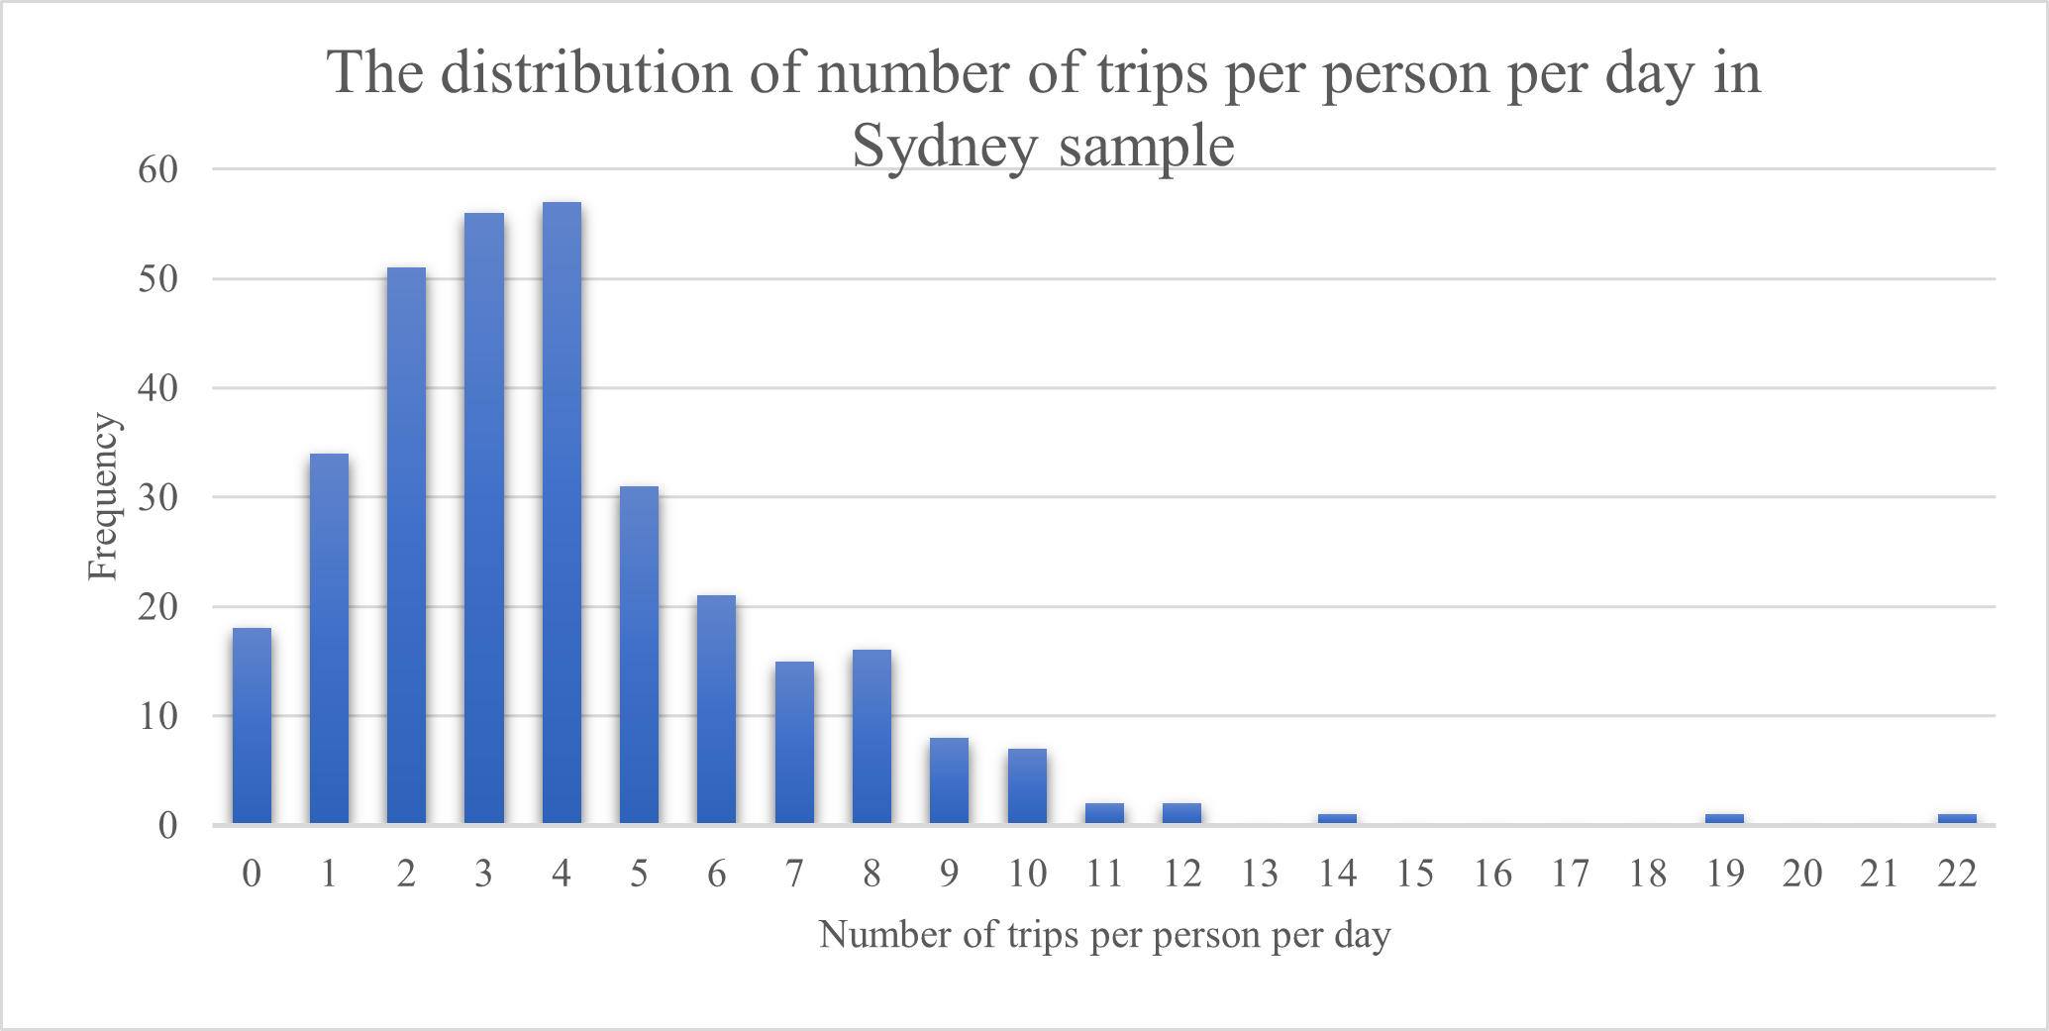
1- Travel Behaviour Analysis
Distribution of the daily number of recorded trips
Log-normally distributed

Slide 52
1- Travel Behaviour Analysis
Mode | % Modal share |  | Distance (Kilometers)
 | Sydney | Chicago | Sydney |  | Chicago
 |  |  | Mean | Std | Mean | Std
Bike | 0.41 | 13.26 | 3.31 | 2.18 | 4.37 | 4.98
Bus | 0.96 | 8.36 | 8.93 | 6.66 | 5.18 | 6.69
Private vehicle as a driver | 49.24 | 20.65 | 12.19 | 20.75 | 14.61 | 30.62
Private vehicle as a passenger | 8.12 | 5.58 | 15.48 | 29.24 | 20.15 | 63.51
Taxi | 0.41 | 0.90 | 10.97 | 8.66 | 8.29 | 5.72
Train | 4.81 | 11.98 | 14.75 | 10.19 | 9.58 | 9.04
Walk | 36.04 | 39.26 | 0.84 | 0.91 | 0.87 | 1.25

Slide 53
2-Time-use Behaviour Analysis
Activities are categorised into 5 main groups
1- Personal care
Resting, sleeping, doing sport, etc.
2- Maintenance
Doing laundry, preparing meals, etc.
4- Recreation or leisure
5- Voluntary work
3- Employment or education
Workingat the primary job, working at other jobs, etc.
Spending time on social media, watching TV, reading books, etc.
Caring for adults, childcare, pet care activities, etc.

Slide 54
2-Time-use Behaviour Analysis
American Time Use Survey 2022 annual daily averages (hours/day)
Our sample of 77 Chicago residents
Activity title | Duration in hours/day (conditional on participating in that activity)
 | Sydney |  |  | Chicago
 | Mean | Std | Median | Mean | Std | Median
Personal care | 11.1 | 3.4 | 10.3 | 11.5 | 3.9 | 10.9
Maintenance | 2.0 | 2.5 | 1.0 | 1.8 | 2.4 | 1.0
Employment/Educational | 6.0 | 3.1 | 6.7 | 6.0 | 3.1 | 6.4
Recreation and leisure | 4.1 | 3.6 | 3.3 | 3.7 | 3.1 | 3.3
Voluntary work | 3.3 | 4.8 | 1.3 | 2.5 | 4.2 | 1.1
Travel | 1.6 | 1.2 | 1.2 | 1.9 | 1.6 | 1.5
Activity tiltle | Mean
Personal care | 10.6
Maintenance | 2.2
Employment/Educational | 5.8
Recreation and leisure | 3.7
Voluntary work | 1.5

Slide 55
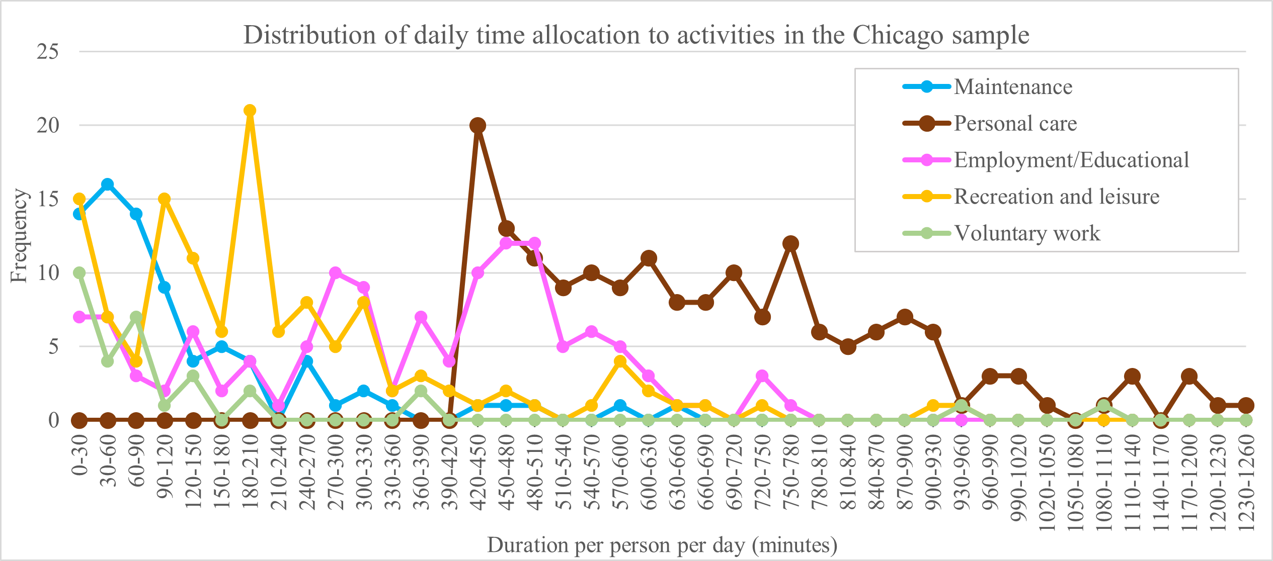
2-Time-use Behaviour Analysis
Distribution of daily time allocation to activities in the Chicago sample

Slide 56
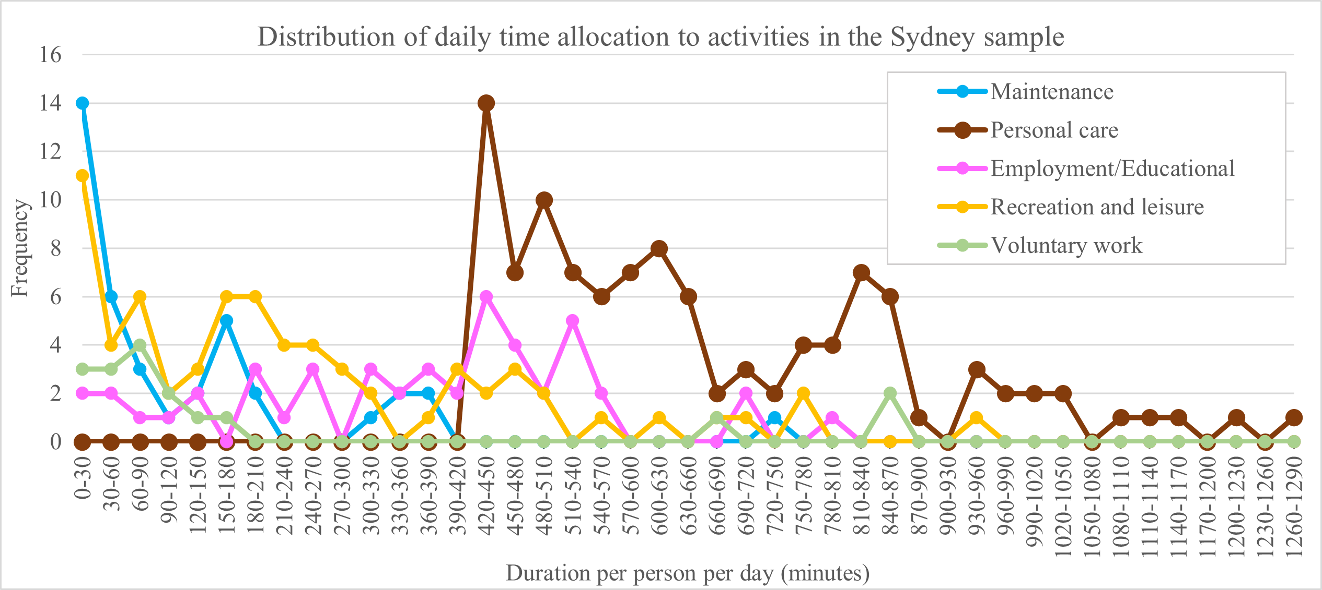
2-Time-use Behaviour Analysis
Distribution of daily time allocation to activities in the Sydney sample

Slide 57
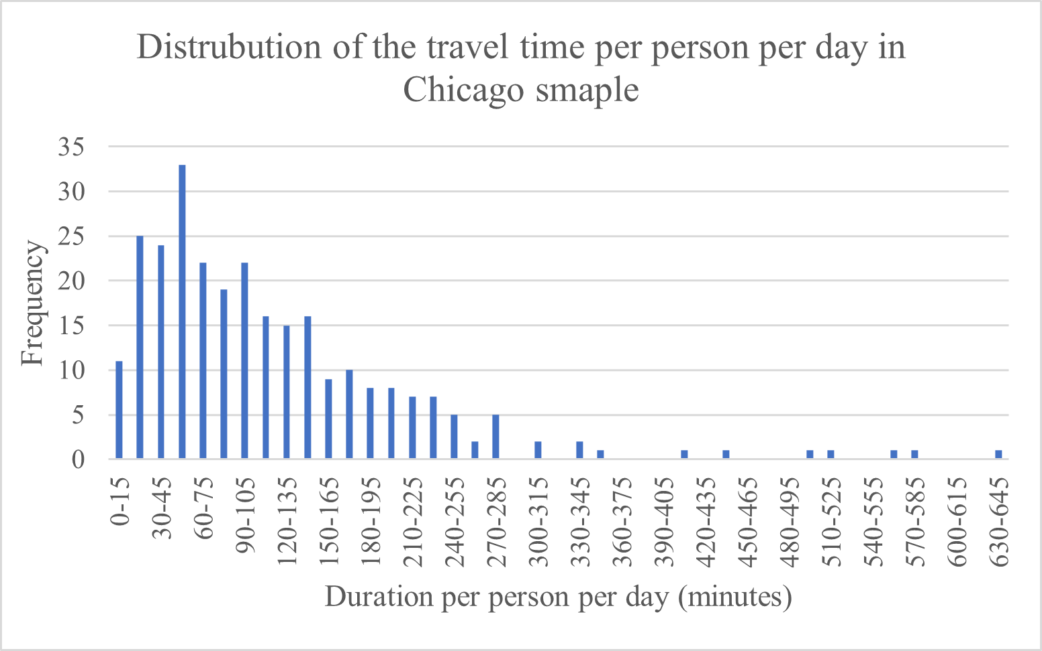
2-Time-use Behaviour Analysis
Distribution of daily travel time in the Chicago sample.

Slide 58
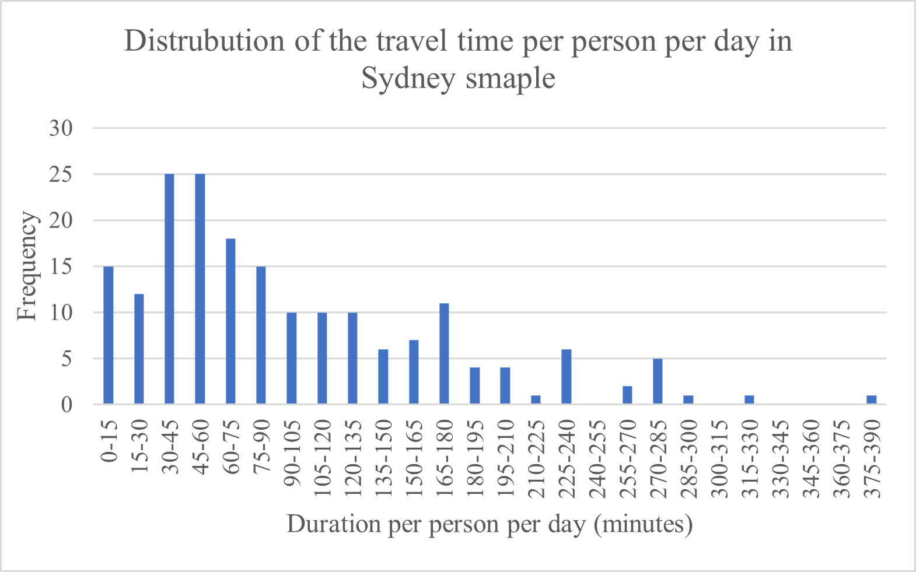
2-Time-use Behaviour Analysis
Distribution of daily travel time in the Sydney sample.

Slide 59
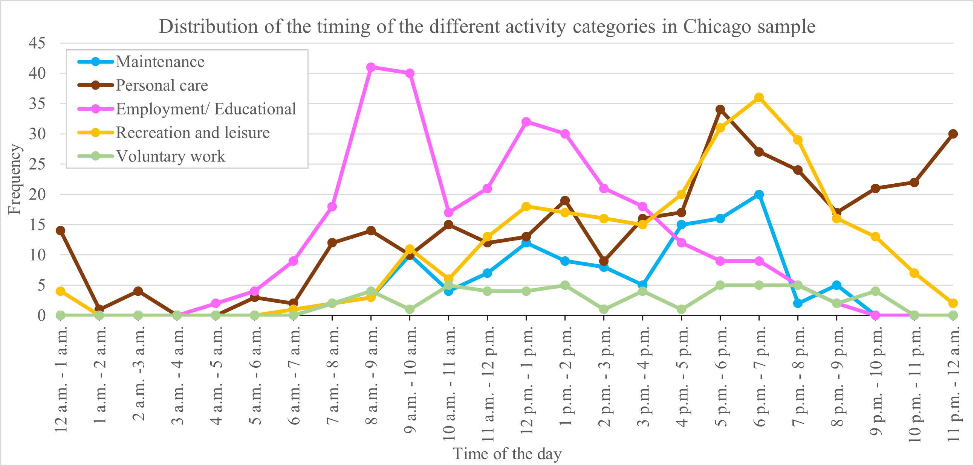
2-Time-use Behaviour Analysis
Timing of all activities in Chicago samples

Slide 60
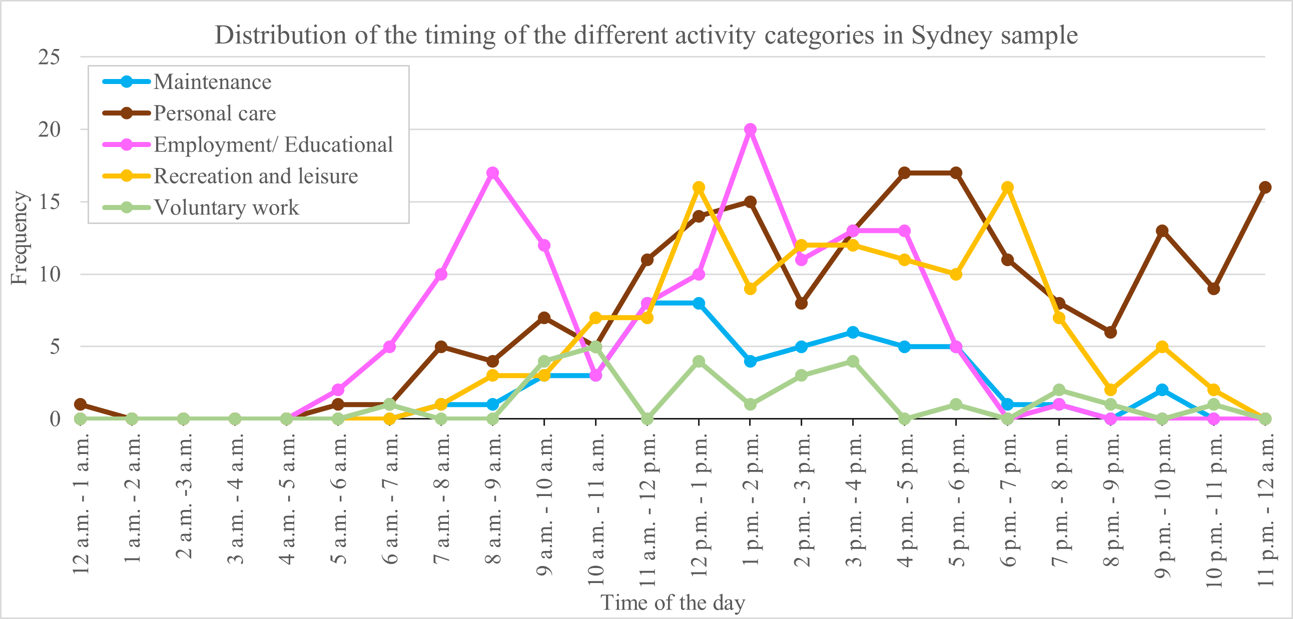
2-Time-use Behaviour Analysis
Timing of all activities in Sydney samples

Slide 61
2-Time-use Behaviour Analysis
174 multitasking activities are recorded.
Percentage of multitasking behaviour in Chicago is provided.
Mostly occurs in public transport and while walking
 | Mode of transport- Chicago sample
Activities | Bike | Bus | Driver | Passenger | Taxi | Train | Walk | Total
Employment/Educational
Checking emails | - | 0.6 | - | - | - | 3.4 | - | 4.0
Recreation/leisure | 0.0 | 0.0 | 0.0 | 0.0 | 0.0 | 0.0 | 0.0 | 0.0
Listening to radio/podcasts/music | 2.3 | 14.9 | 4.0 | 5.2 | 0.6 | 16.1 | 20.7 | 63.8
Reading books | - | 0.6 | - | - | - | 3.4 | - | 4.0
Spending time on social media | - | 6.3 | - | 4.0 | 0.6 | 5.7 | 3.4 | 20.1
Spending time with family/friends | - | - | - | 4.0 | - | 1.1 | - | 5.2
Contact friends or family on a call | 0.6 | 1.1 | - | - | - | 0.6 | 0.6 | 2.9
Total | 2.9 | 23.6 | 4.0 | 13.2 | 1.1 | 30.5 | 24.7 | 100.0

Slide 62
Conclusion
One often overlooked element in collecting travel and time-use data through smartphone applications is the recruitment of participants.
We experimented with different recruitment setups and strategies including hiring through a market research company and social media advertisement platforms.
We tested different social media platforms, including Twitter, Google, and Facebook was the most flexible and efficient one for recruiting participants. It is also better to mention the incentive on the first page of the landing page.
1
2
3

Slide 63
Conclusion
Participants from social media advertisements were more genuine and fully participated for more days compared to those from market research companies.
If researchers want to collect data in another country, social media advertisement appears to be superior and market research companies might not be able to help. It also has lower costs.
A GPS-aware smartphone app (Fourstep) enables integrated travel and time-use data collection while capturing multitasking and activity timing which is crucial for travel behaviour analysis.
4
5
6

